Slide 1

How have environmental issues affected Canada?
SS6G7a

Slide 2
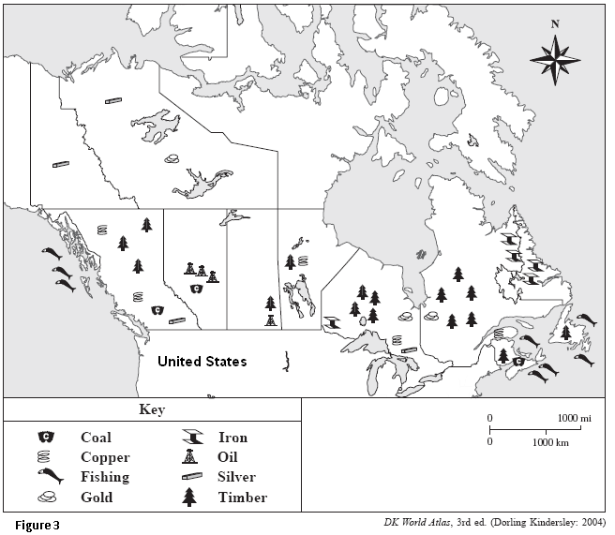
Activating Strategy
Look at the map to the left showing the natural resources found in Canada.
With a seat partner, identify the type of environmental issues that Canada might experience.

Slide 3

Environmental Issues in Canada
Acid Rain
Pollution of the Great Lakes
Extraction & Use of Natural Resources

Slide 4
As we discuss the Environmental Issues in Canada, we will summarize the information on a graphic organizer.

Slide 5

Acid Rain
What is acid rain?
http://glencoe.mcgraw-hill.com/sites/dl/free/0078778026/161752/00053411.html
http://www.youtube.com/watch?v=HE6Y0iEuXMQ
http://www.youtube.com/watch?v=JRvvPOAWMAo

Slide 6

Causes of Acid Rain in Canada
Polluted gases released into the air from:
Emissions from power plants that burn fossil fuels
Emissions from factories that process minerals mined in Canada
Emissions from cars

Slide 7
Effects of Acid Rain in Canada
Polluted farmland
Dying trees
Dead plants and animals in lakes
Damage to buildings and statues (especially made of granite, marble, and limestone)
Lower profits for industries

Slide 8

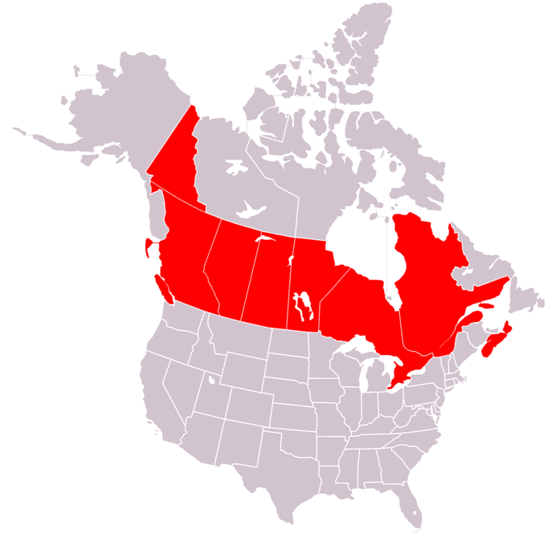
Pollution of the
Great Lakes
Great
Lakes

Slide 9

Pollution of the Great Lakes
Polluted by waste from industries, sewage treatment plants, and run-off (pesticides, fertilizers, oil, grease, salt from highways)
Acid rain is killing the plants and fish
U.S. and Canada are both working to control industry, change to gas powered stations instead of coal-powered, add lime to help neutralize the effects of acid rain

Slide 10

Distributed
Summarizing
If you lived in Canada, identify ways in which you might be able to help reduce the amount of air pollution and acid rain in the environment.

Slide 11


Extraction & Use of Natural Resources

Slide 12
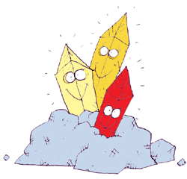
Extracting Minerals from the Canadian Shield
Minerals from the Canadian Shield are valuable exports and power many industries
Extracting minerals can cause damage the environment:
  Toxic waste gets into the ground and water
  Plants and animals lose their place to live
  Emissions cause acid rain

Slide 13
Use of Rivers on the Canadian Shield
Rivers on the Canadian Shield produce hydroelectricity (electricity created by flowing water)
Hydroelectricity has caused problems because of the creation of dams, reservoirs, and change in river flow.
As a result, there is flooding, erosion, and animals lost their place to live and their source of food.

Slide 14
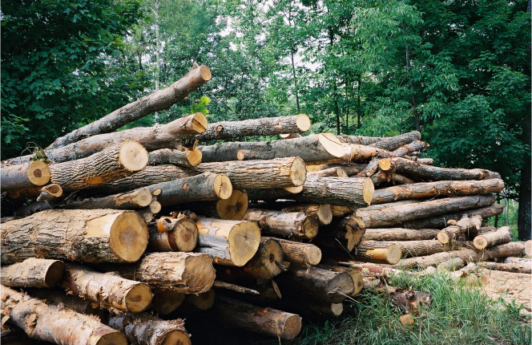
Extracting Timber from the
Canadian Shield
Trees are harvested as timber to make wood and paper products
Cutting down a lot of trees in the same area (clear-cutting) can cause flooding and erosion into rivers
New trees can be planted but take many years to grow
The government is trying to help by restoring damaged areas and setting aside land to be protected

Slide 15
Distributed Summarizing
Do you think the benefits of extracting Canada’s natural resources outweigh the harmful effects of extracting its natural resources? Why or why not?
Share your thoughts with a partner.

Slide 16

Summarizing
Strategy
Select one of the following tasks to demonstrate your understanding of the environmental issues in Canada:
Make a bumper sticker illustrating an environmental issue affecting Canada (must include at least one environmental concern and its causes not general statements such as Save Canada’s environment)
Make a Recipe Card about environmental issues in Canada
Write an editorial to a newspaper describing an environmental issue affecting Canada

Slide 17
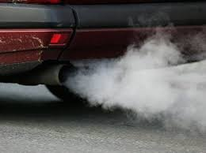

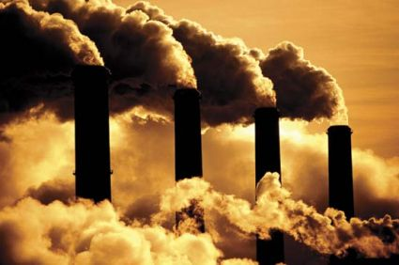
Emission – the production and release of something
Emission
Back

Slide 18
Run-off – leave or escape from a place
Back

Slide 19
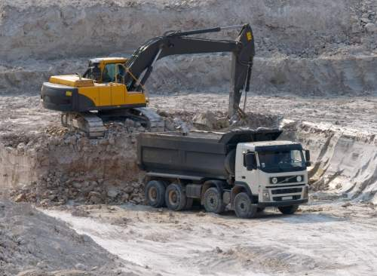
Extraction – the action of taking something out
Back

