Slide 1
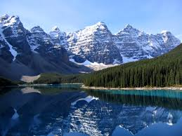
Physical Features
of
Canada

Slide 2
EQ: Where are the major physical features of Canada located?
What do we need to be able to do?
Locate on a world and regional political-physical map: the St. Lawrence River, Hudson Bay, Atlantic Ocean, Pacific Ocean, the Great Lakes, Canadian Shield, and Rocky Mountains.

Slide 3
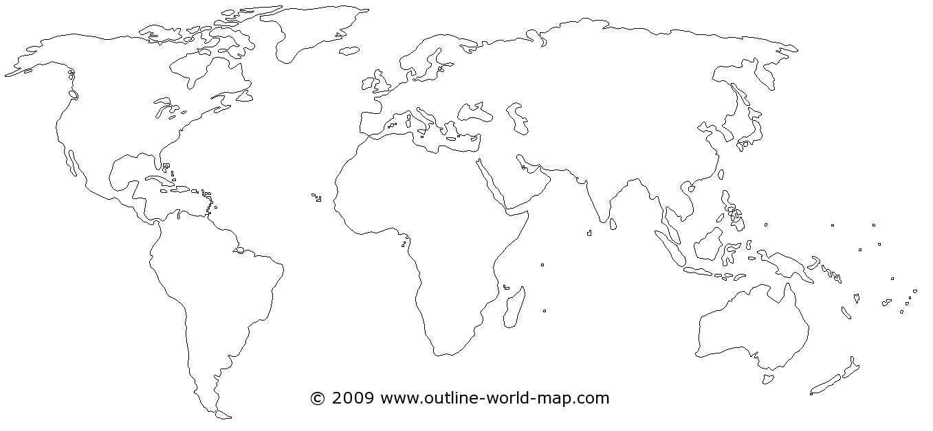
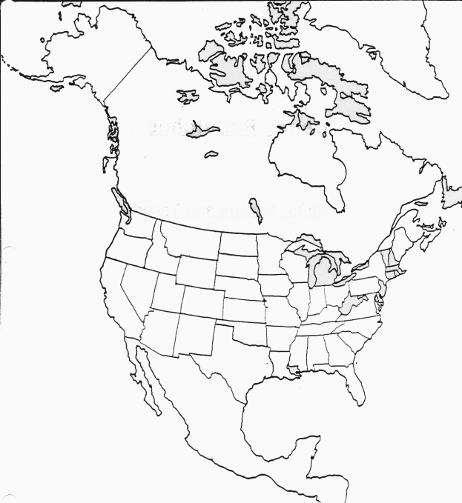
Where is Canada?
Describe Canada’s location on the world map.
Describe Canada’s location in relation to the United States.

Slide 4
Where are the major physical features of Canada located?
Today, we are going to locate …
Atlantic Ocean
Pacific Ocean
St. Lawrence River
Hudson Bay
Great Lakes
Rocky Mountains
Canadian Shield

Slide 5
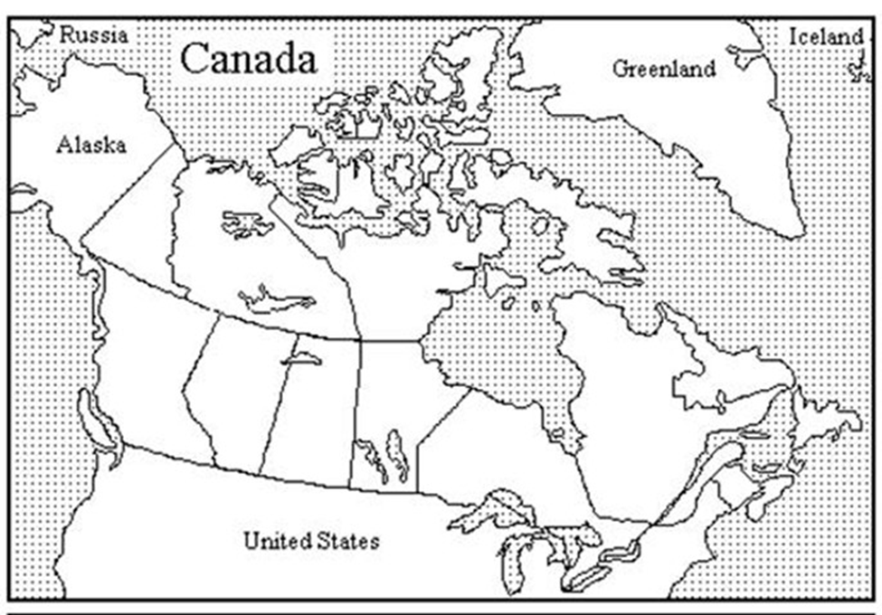
Atlantic Ocean
The Atlantic Ocean is on Canada’s east coast
It is the second largest ocean.
Atlantic Ocean

Slide 6
Pacific Ocean
The Pacific Ocean is on Canada’s west coast.
Largest and deepest ocean
Pacific Ocean

Slide 7
St. Lawrence River
Connects the Great Lakes to the Atlantic Ocean
Important to Canada’s history because it allowed explorers to travel into North America by water
Important natural resource – water and trade route

Slide 8
St. Lawrence River
St. Lawrence River

Slide 9
Hudson Bay
A gulf in east-central Canada
Connected to Atlantic and Arctic Oceans
Hudson
Bay

Slide 10
Great Lakes
form part of the border with the United States.
Lake Superior, Lake Huron, Lake Erie, and Lake Ontario are split between the United States and Canada. Lake Michigan is only in the U.S.

Slide 11
Great Lakes
Great Lakes

Slide 12
Rocky Mountains
Stretch over 3000 miles from British Colombia in Canada to New Mexico in the United States
Mount Robson is the tallest peak in the Canadian Rockies at nearly 13,000 feet.

Slide 13
Rocky Mountains
Rocky Mountains

Slide 14
Canadian Shield
covers a large part of eastern and central Canada
It has ancient rock just below and sometimes sticking out of the soil.
The area is known for its thin, rocky soil and rough, rolling landscape. This region has many lakes and rivers and is rich in minerals

Slide 15
Canadian Shield * see the next slide, as well
Canadian
Shield

Slide 16
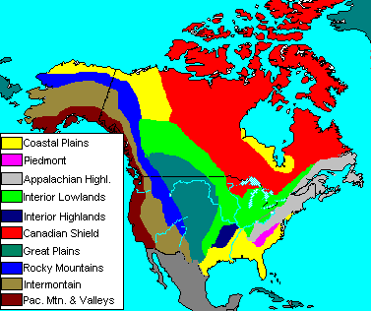
Canadian Shield

